Slide 1
Introduction to E-Government
Exercise 06 – OOP Processes and core components to comply to SDGR
Group 05 – Resubmission of Exercise 06
02.07.2023
Group Members:
Emal Ismail
Vidusha Silva
Kyriakos Kiouranas

Slide 2
Agenda
BPMN Collaboration diagram for overall process
UML Sequence flow diagram
Major building blocks and technology components need to make the OOP public service work cross border

Slide 3
Selected project for the Exercise
Life SG
'LifeSG' provides one stop access to more than 100 government services and information for citizens
Embedded with MyInfo portal - A “Tell Us Once” Service that facilitates Online Transactions for Individuals
All Singpass users (authentication for LifeSG login) are automatically provisioned with a MyInfo profile
MyInfo allows Singapore citizens and residents to pre-fill digital forms with their personal data
Personal data sharing for private and public sector transactions are facilitated by requesting the user's consent with MyInfo

Slide 4
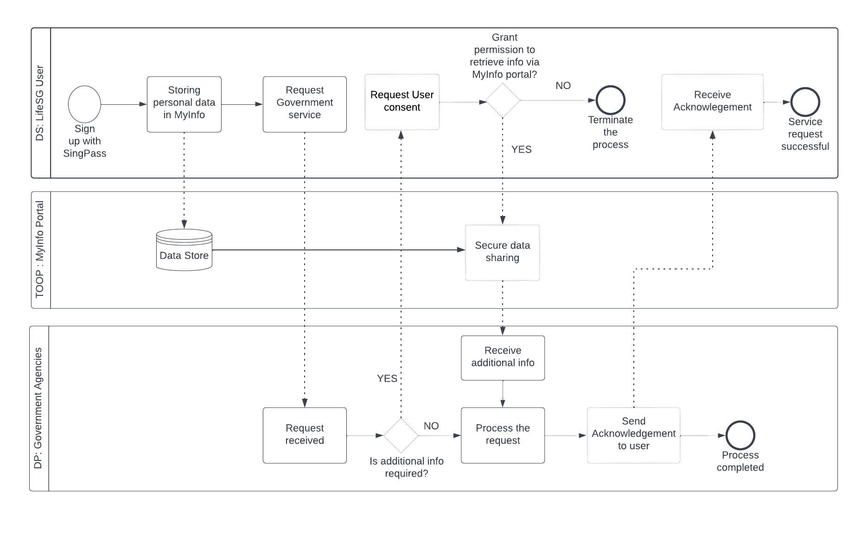
BPMN collaboration diagram for overall process

Slide 5
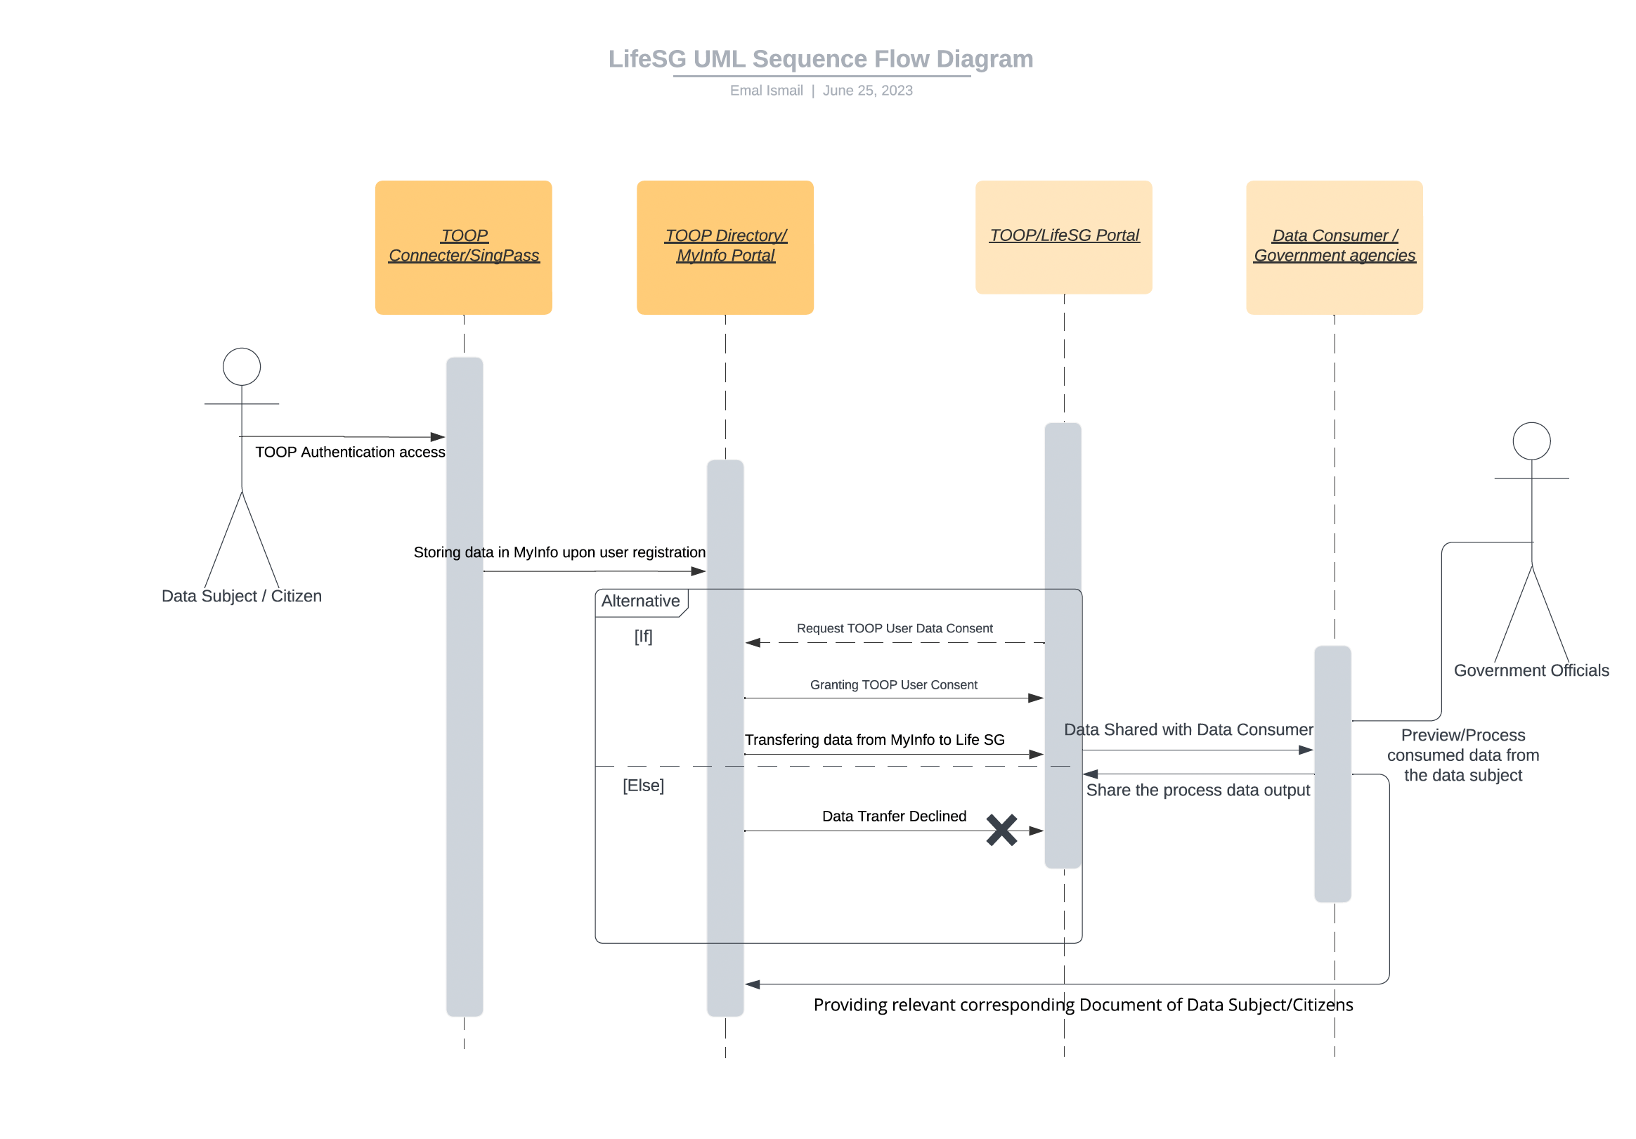
UML Sequence flow diagram

Slide 6
Major building blocks and technology components need to make the OOP public service work cross border
Although, all the mentioned building blocks of the SDGR is essential to be implemented, but the below-mentioned building blocks to facilitated cross-border OOP is crucial in our opinion:
Identification and Authentication: The architecture of the Once-Only Technical System reuses the eID building block as it is today. Should the eID building block change, the technical specifications would be adapted to support the changes.
Once-Only Technical System Architecture: The SDGR aims to make it easier for a user to initiate and execute, subject to specified constraints, a set of procedures online where:
The OOP Technical System establishes a general-purpose data exchange ecosystem for the public sector in Europe. Hence, such a data exchange procedure should be adapted in Asia to implement the OOP cross-border in LifeSG project.
Semantic Repository: to achieve semantic interoperability, Member States need to make detailed agreements on the semantics of evidence types that are to be exchanged using the OOP Technical System.
Once-only Common Service: The Once-Only Technical System supports situations in which an Online Procedure Portal, when performing an online procedure, requests an evidence from a data service in a different Member State.
Evidence Broker, Data Service Directory, and Semantic Repository

Slide 7
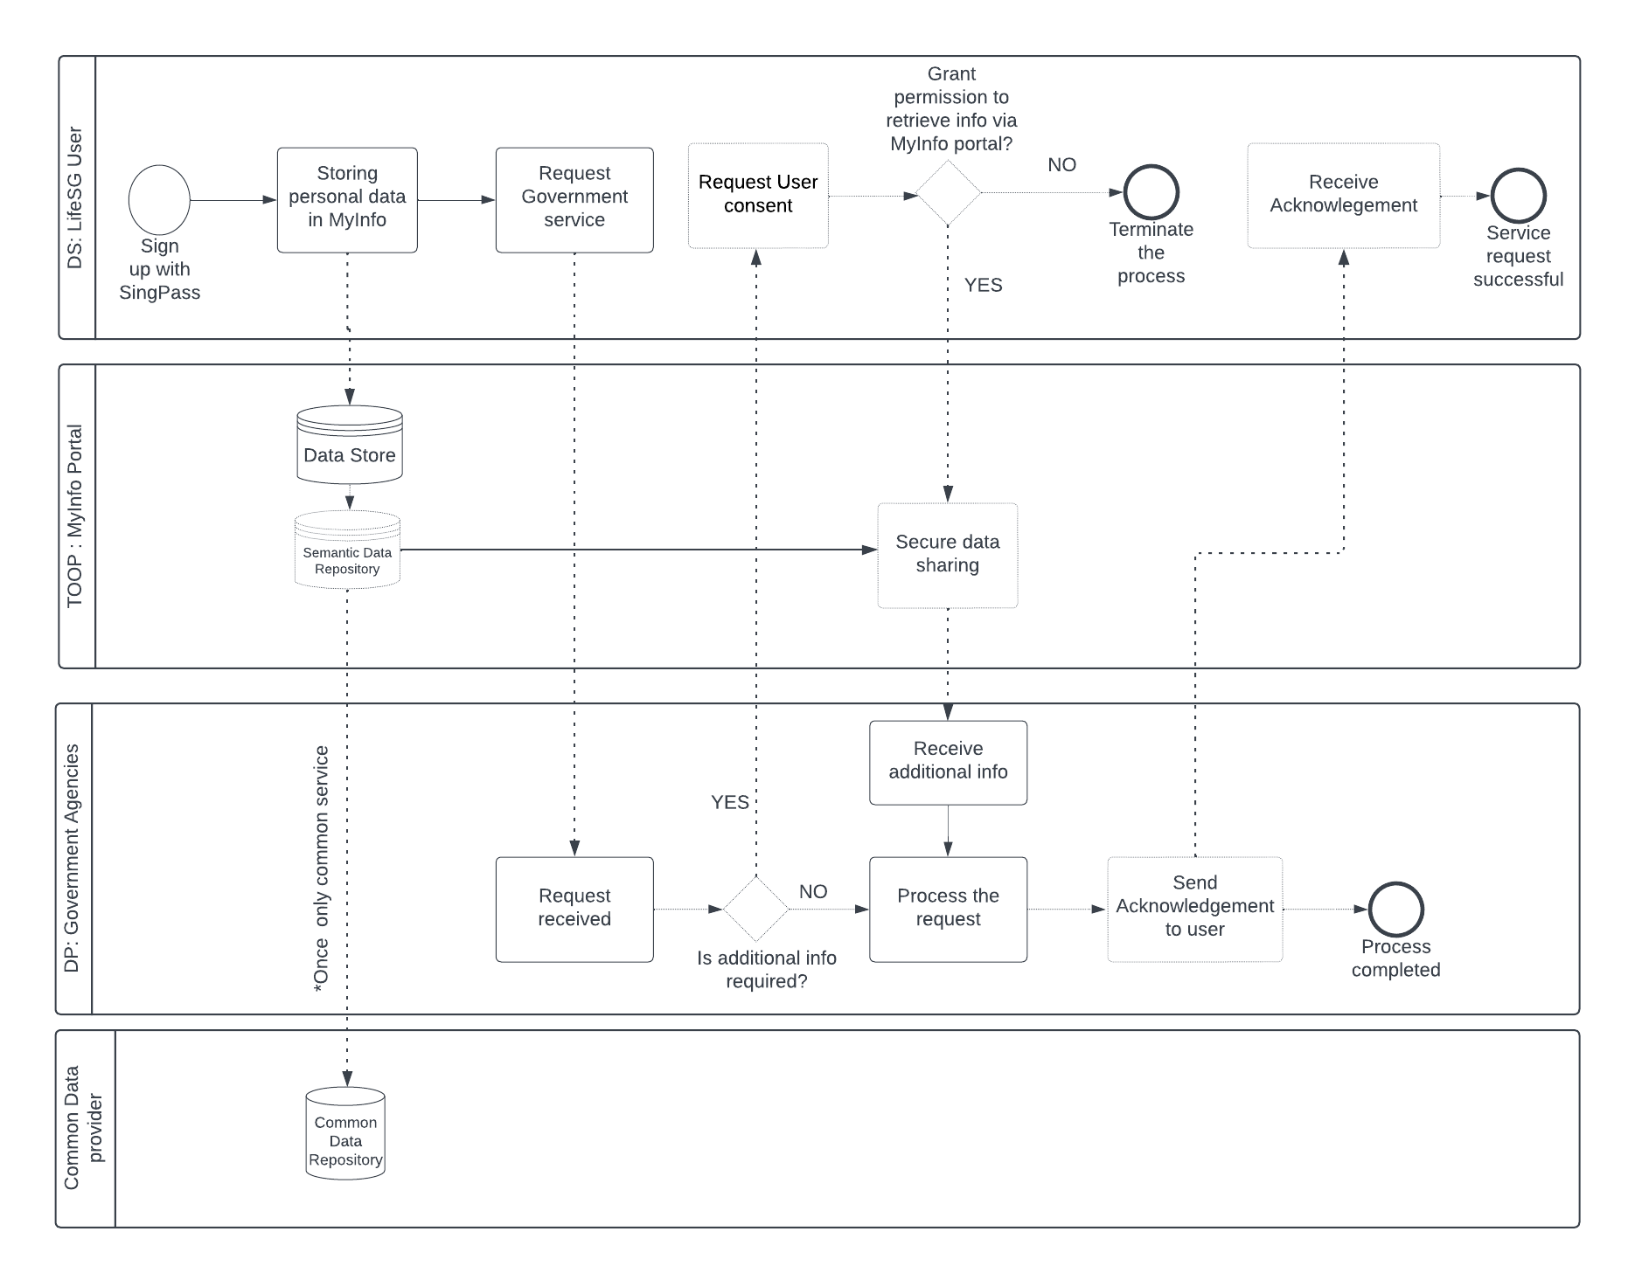
Improved BPMN collaboration diagram to facilitate cross boarder services

Slide 8
References
https://ec.europa.eu/digital-building-blocks/wikis/display/TDD/1.+OnceOnly+Technical+System+High+Level+Architecture+Snapshot+Q2
https://www.smartnation.gov.sg/initiatives/strategic-national-projects/lifesg
https://www.developer.tech.gov.sg/products/categories/digital-identity/myinfo/overview.html

Slide 9
Thank you for your attention

